Slide 1
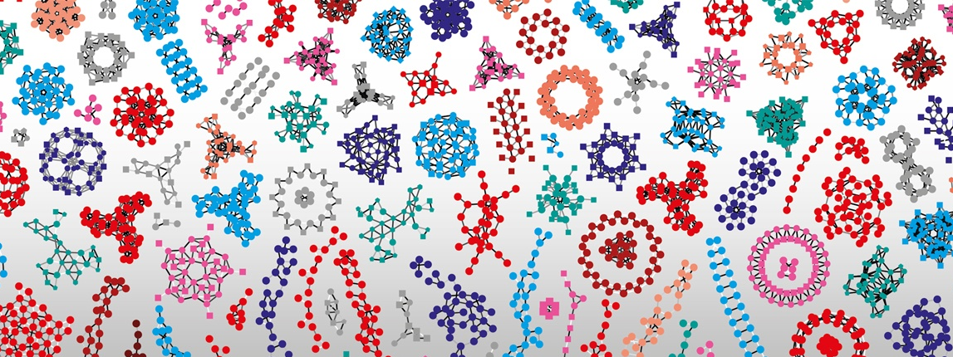

Introduction à R Shiny
Frédéric Schütz
(avec du matériel emprunté à Linda Dib et Martial Sankar)

Slide 2
I
♥
?

Slide 3
Matériel de cours
https://github.com/IFB-ElixirFr/R-Shiny_training_2019-07

Slide 4
Data analysis workflow
Visualize
Prepare
Import
Tidy
Transform
Communicate
Model
R
Adapted from Hadley Wickham
"R for data analysis"

Slide 5
Data analysis workflow
Visualize
Prepare
Import
Tidy
Transform
Communicate
Model
R
Adapted from Hadley Wickham
"R for data analysis"

Slide 6
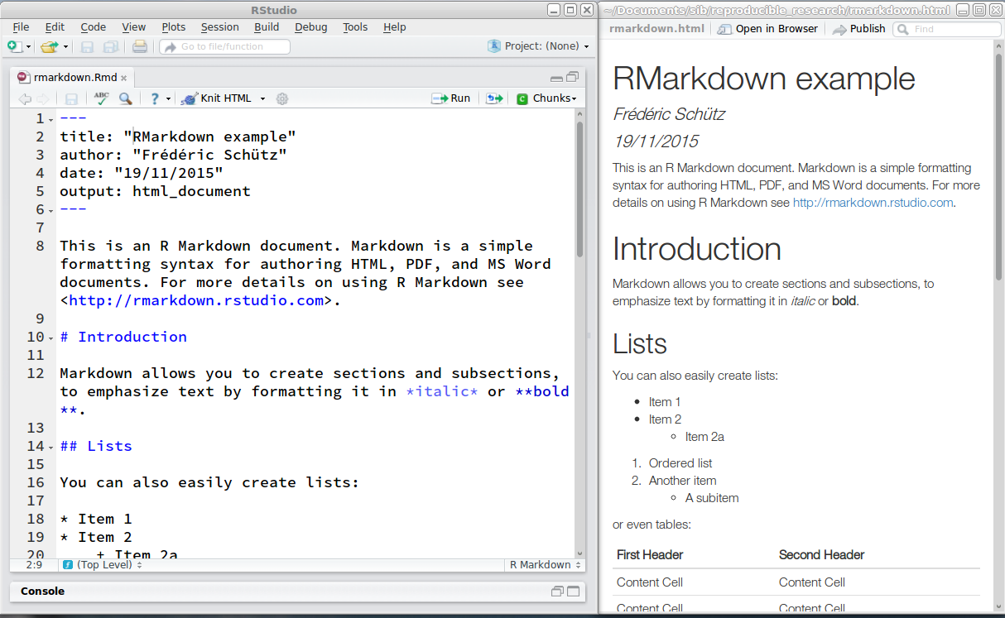
knitr and R Markdown

Slide 7
Visualising data

Slide 8
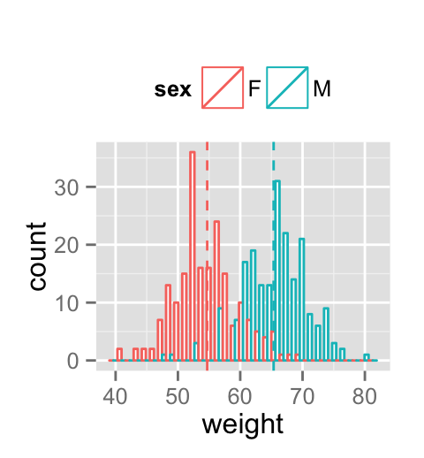
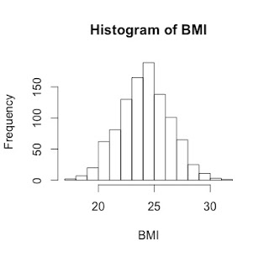
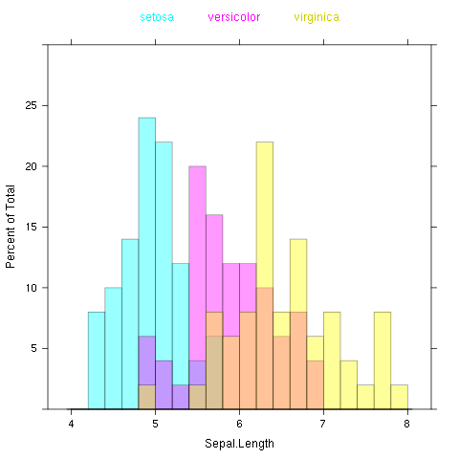
3 models for graphics in R
Base graphics
Lattice
ggplot

Slide 9
Interactive graphs

Slide 10
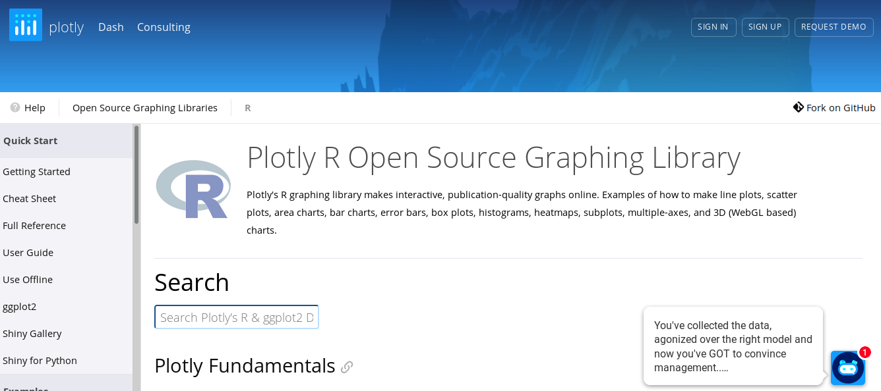

Slide 11
Plotly & ggplot2
library(plotly)
data(diamonds)
p <- ggplot(
data = diamonds,
aes(x = carat, y = price)) +
geom_point(aes(text = paste("Clarity:", clarity)), size = 4) +
geom_smooth(aes(colour = cut, fill = cut)) +
facet_wrap(~ cut)
(gg <- ggplotly(p))

Slide 12
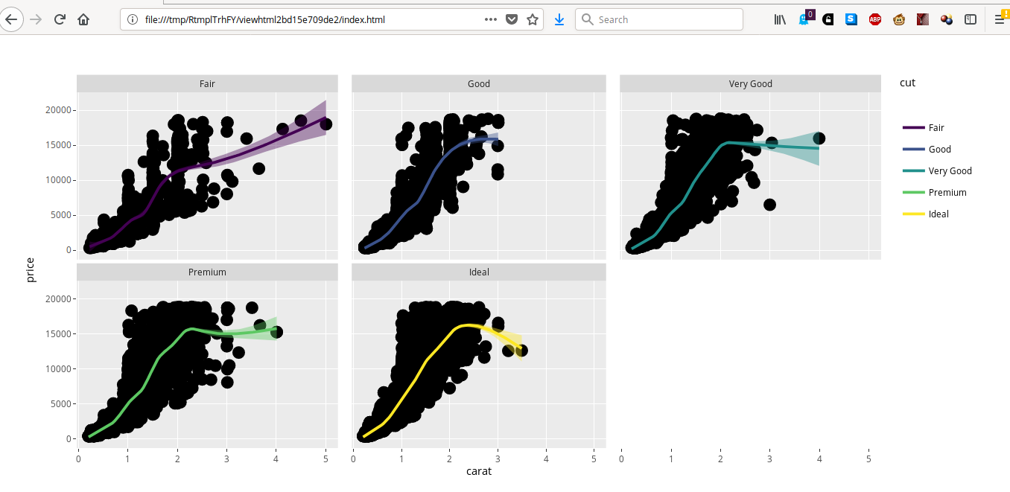

Slide 13
Data analysis workflow
Visualize
Prepare
Import
Tidy
Transform
Communicate
Model
R
Adapted from Hadley Wickham
"R for data analysis"

Slide 14
Data analysis workflow
Visualize
Prepare
Import
Tidy
Transform
Communicate
Model
R
Adapted from Hadley Wickham
"R for data analysis"

Slide 15
"Interactive" analysis with R (and Rstudio): accessing an R application

Slide 16
Example: simulation
n1 <- 25
n2 <- 25
d <- 2
sd <- 2.45
p <- NULL
for (i in 1:10000) {
data1 <- rnorm(n1, mean=0, sd=sd)
data2 <- rnorm(n2, mean=d, sd=sd)
p <- c(p, t.test(data1, data2)$p.value)
}
sum(p < 0.05) / length(p)

Slide 17
Example: simulation
n1 <- 25
n2 <- 25
d <- 2
sd <- 2.45
p <- NULL
for (i in 1:10000) {
data1 <- rnorm(n1, mean=0, sd=sd)
data2 <- rnorm(n2, mean=d, sd=sd)
p <- c(p, t.test(data1, data2)$p.value)
}
sum(p < 0.05) / length(p)
[1] 0.7997

Slide 18
Example: new simulation
n1 <- 35
n2 <- 15
d <- 2
sd <- 2.45
p <- NULL
for (i in 1:10000) {
data1 <- rnorm(n1, mean=0, sd=sd)
data2 <- rnorm(n2, mean=d, sd=sd)
p <- c(p, t.test(data1, data2)$p.value)
}
sum(p < 0.05) / length(p)

Slide 19
Example: new simulation
n1 <- 35
n2 <- 15
d <- 2
sd <- 2.45
p <- NULL
for (i in 1:10000) {
data1 <- rnorm(n1, mean=0, sd=sd)
data2 <- rnorm(n2, mean=d, sd=sd)
p <- c(p, t.test(data1, data2)$p.value)
}
sum(p < 0.05) / length(p)
[1] 0.7239

Slide 20
Example: new simulation
n1 <- 55
n2 <- 15
d <- 2
sd <- 2.45
p <- NULL
for (i in 1:10000) {
data1 <- rnorm(n1, mean=0, sd=sd)
data2 <- rnorm(n2, mean=d, sd=sd)
p <- c(p, t.test(data1, data2)$p.value)
}
sum(p < 0.05) / length(p)
[1] 0.769

Slide 21
Can we provide better access to these… … results …visualizations … applications ?

Slide 22
1. Through a dedicated application

Slide 23
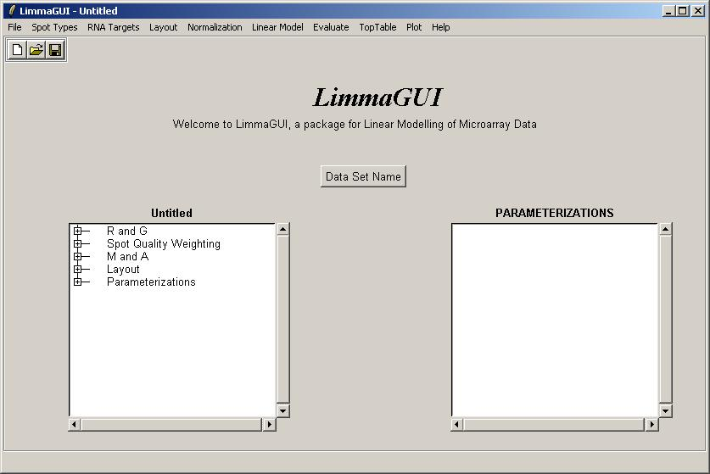
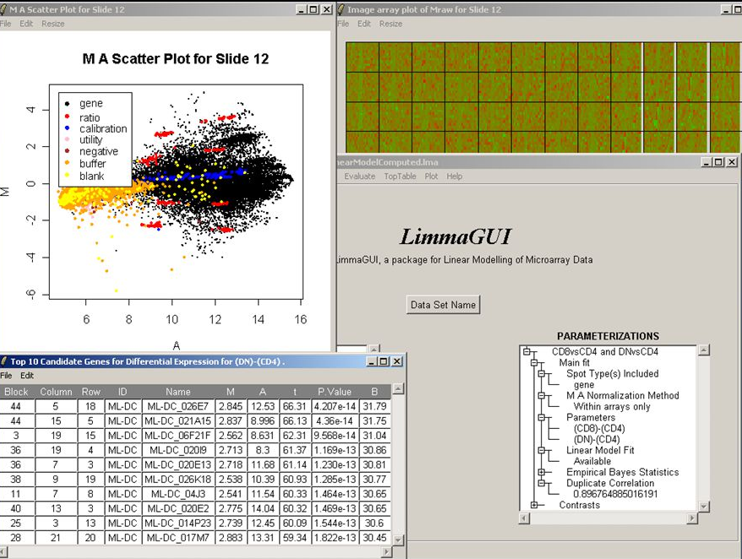
Example: limmaGUI

Slide 24
2. Through a web application

Slide 25
Web browser
Web page
Client
Local filesystem

Slide 26
plotly
https://plot.ly/ggplot2/getting-started/

Slide 27
Web browser
Web server
Client
Server

Slide 28
Web browser
Web server
R
Client
Server

Slide 29
Web browser
Web server
R
Web
framework
R
Client
Server

Slide 30
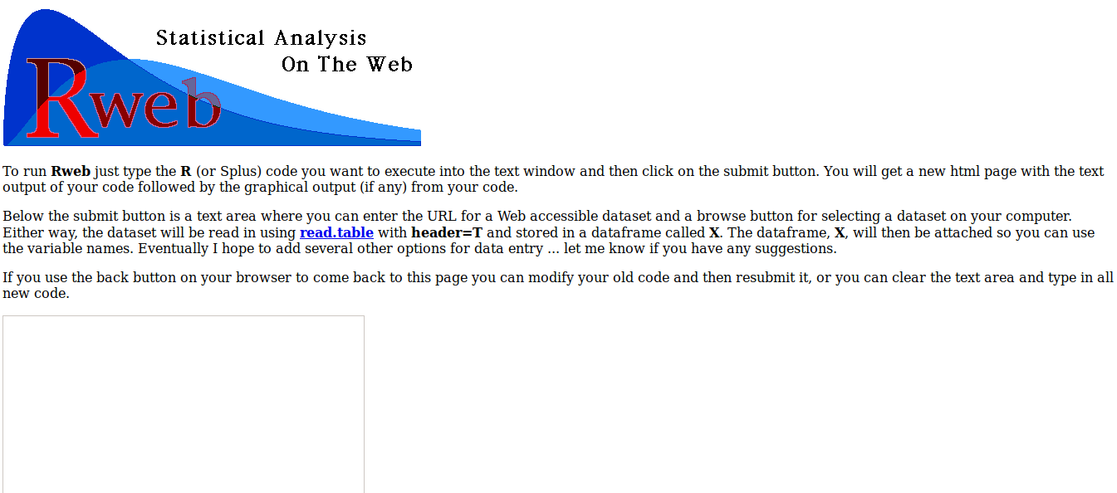

Slide 31
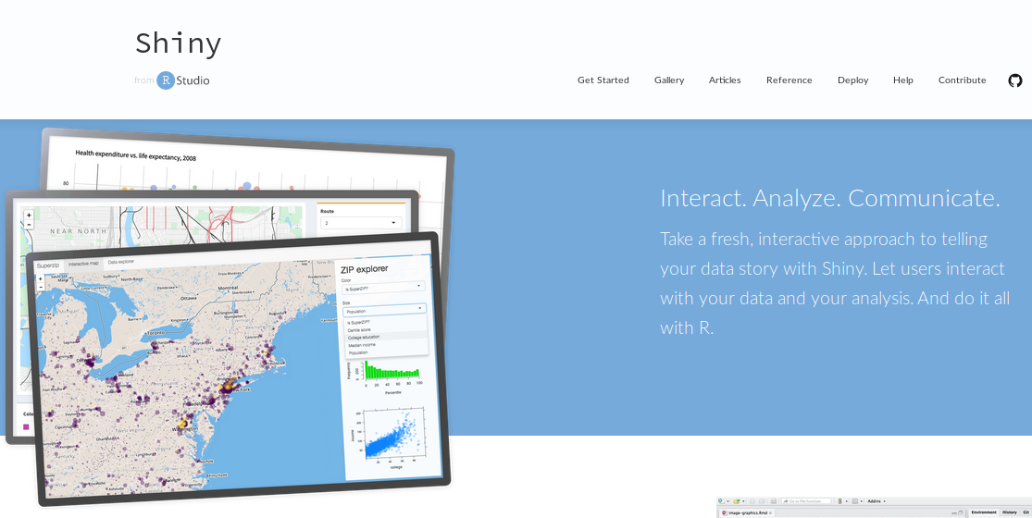
https://shiny.rstudio.com/

Slide 32
Web page
Web browser
Web server
R
Web
framework
R
Client
Server

Slide 33
Web browser
Shiny
Client
Server

Slide 34
" Shiny is an R package that makes it easy to build interactive web apps straight from R.
You can host standalone apps on a webpage or embed them in R Markdown documents or build dashboards.
You can also extend your Shiny apps with CSS themes, htmlwidgets, and JavaScript actions."

Slide 35
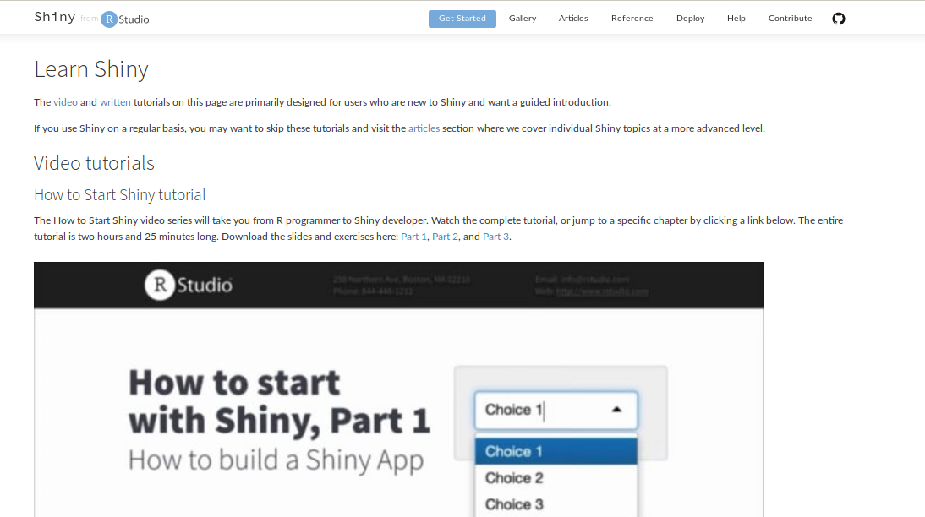
Documentation on Shiny
https://shiny.rstudio.com/tutorial/

Slide 36
Setting up shiny in R
> install.packages("shiny")
> library(shiny)

Slide 37
Examples of Shiny apps

Slide 38
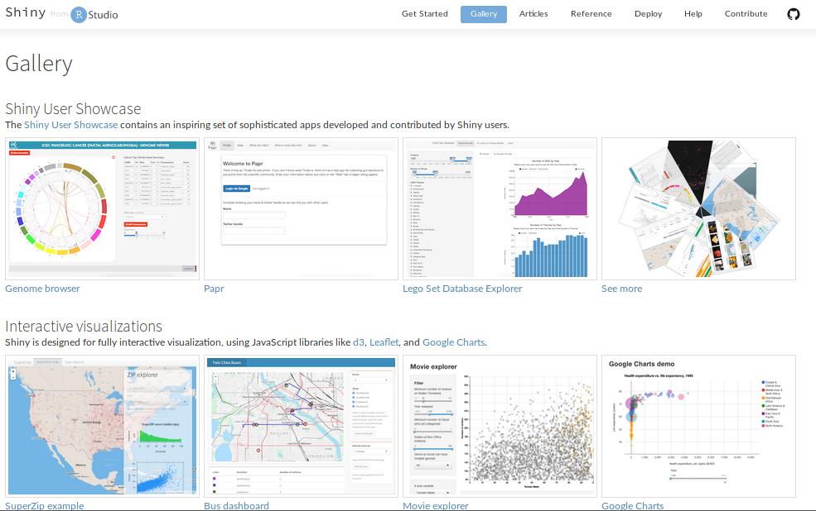
https://shiny.rstudio.com/gallery/

Slide 39
https://marionilab.cruk.cam.ac.uk/iSEE_allen/

Slide 40
Shiny includes 11 examples of apps
runExample("01_hello") # a histogram
runExample("02_text") # tables and data frames
runExample("03_reactivity") # a reactive expression
runExample("04_mpg") # global variables
runExample("05_sliders") # slider bars
runExample("06_tabsets") # tabbed panels
runExample("07_widgets") # help text and submit buttons
runExample("08_html") # Shiny app built from HTML
runExample("09_upload") # file upload wizard
runExample("10_download") # file download wizard
runExample("11_timer") # an automated timer

Slide 41
Creating my first Shiny app

Slide 42
Anatomy of a Shiny app
A simple shiny app consists of two components:
ui (user interface) creates the layout of the application and the user controls
server creates the content based on the user’s selections

Slide 43
Anatomy of a Shiny app
One single file app.R (recommended)
ui <- fluidPage(
)
server <- function(input, output) {
}
shinyApp(ui = ui, server = server)

Slide 44
My first Shiny app (not recommended)
Two files in the same folder (not recommended)
ui.R
server.R
shinyUI(fluidPage(
))
shinyServer(function(input, output) {
})

Slide 45
Anatomy of a shiny app: data flow
ui
Input widgets
Output functions
server
Load data
Load packages
collect
parameters
Conduct analysis – generate tables and graphs
send rendered objects back to UI

Slide 46
Running the Shiny app
Copy/paste the content of app.R or source() its content: app <- source("app.R") app
Use the runApp() function: runApp("test") # Directory runApp("test/app.R") # File
Use RStudio

Slide 47
More about running the shiny app
Run an app from github: runGitHub( repo="shiny", username="lecy")
Run the app in "showcase mode" (run app and show source code) runApp("test", display.mode = "showcase")

Slide 48
Running the Shiny app
> library(shiny)
> app <- source("test1/app.R")
> app
$value
Listening on http://127.0.0.1:3625
^C
> runApp("test1/app.R")
Listening on http://127.0.0.1:3625
Warning in body(fun) : argument is not a function
^C
>

Slide 49
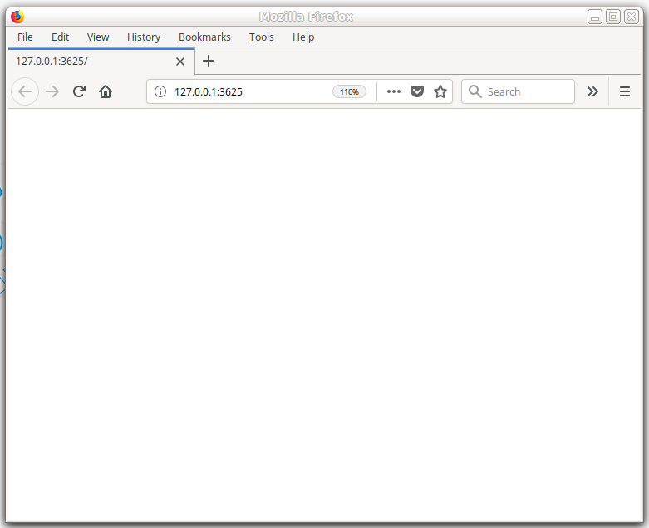
Running the Shiny app
> library(shiny)
> app <- source("test1/app.R")
> app
$value
Listening on http://127.0.0.1:3625
^C
> runApp("test1/app.R")
Listening on http://127.0.0.1:3625
Warning in body(fun) : argument is not a function
^C
>

Slide 50
Using RStudio to create apps

Slide 51
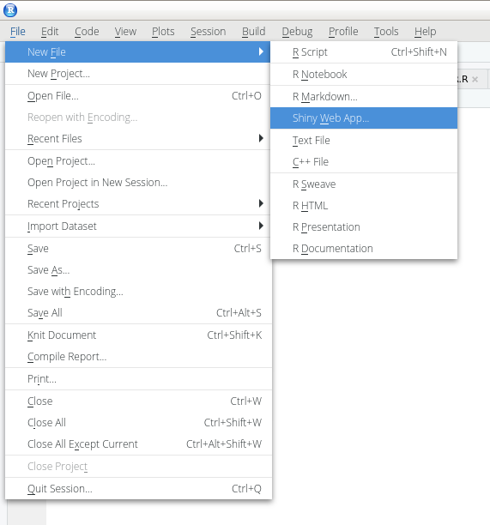
Shiny in RStudio

Slide 52
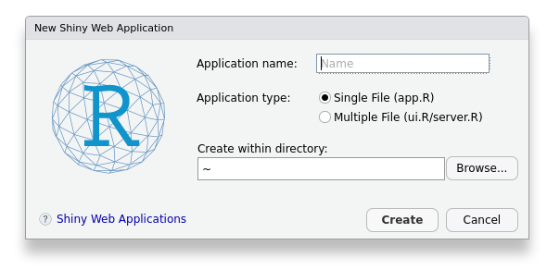

Slide 53
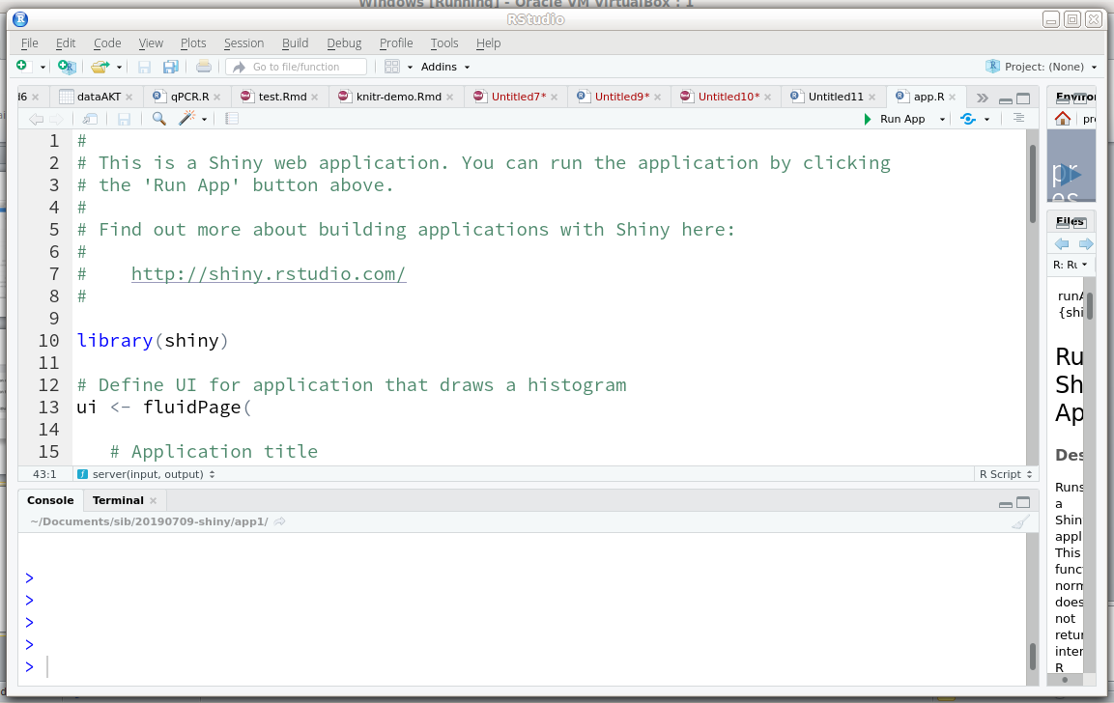

Slide 54
Anatomy of a shiny app: data flow
ui
Input widgets
Output functions
server
Load data
Load packages
collect
parameters
Conduct analysis – generate tables and graphs
send rendered objects back to UI

Slide 55
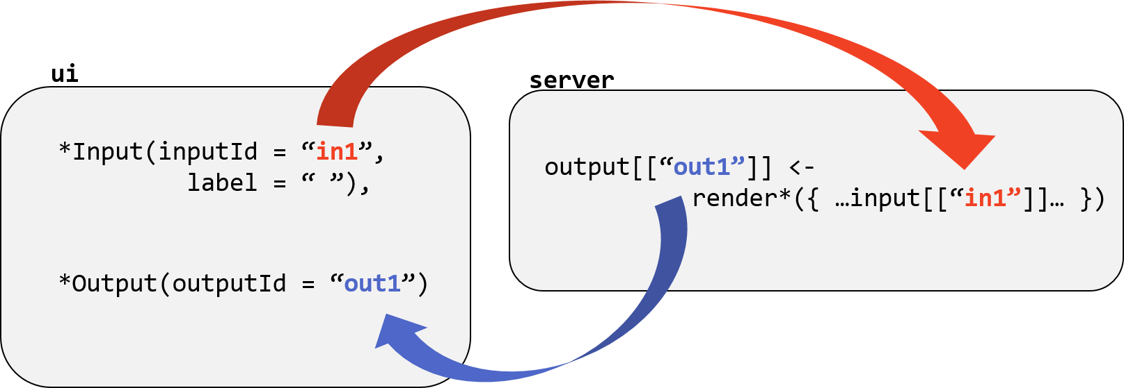
How do the ui and the server communicate= ?
Image Credit: National Socio-Environmental Synthesis Center
https://sesync-ci.github.io/basic-Shiny-lesson/
Notes:
127.0.0.1 is the IP address your laptop uses for itself (it’s the same as ‘localhost’).
Your laptop is hosting a web page (the UI) whose content is controlled by a running R session.
When you run an app through RStudio, that R session is also running the server on your laptop.
The server responds when you interact with the web page, processing R commands and updating UI objects accordingly.
The user interface and the server interact with each other through input and output objects. The user’s interaction with input objects alters parameters in the server’s instructions – instructions for creating output objects shown in the UI.
Writing an app requires careful attention to how your input and output objects relate to each other, i.e. knowing what actions will initiate what sections of code to run at what time.

Slide 56
My first (non trivial) Shiny app: generating random number and plotting and histogram

Slide 57
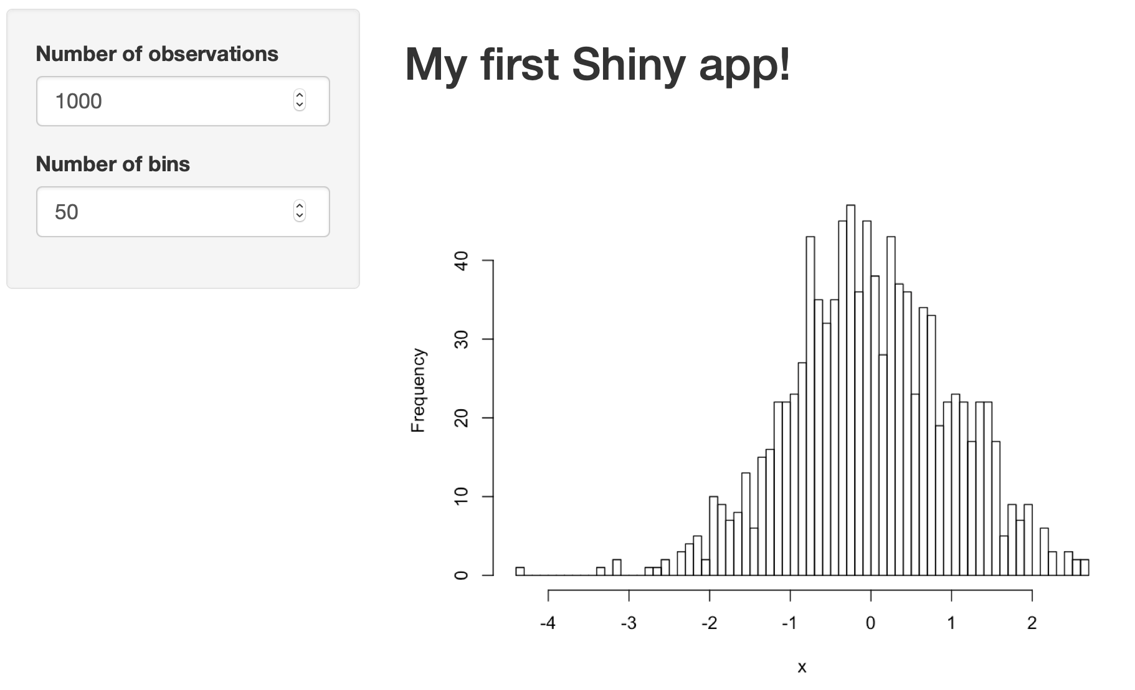

Slide 58
ui <- fluidPage(
titlePanel("Workshop - Example 1 – Basic Histogram"),
sidebarLayout(
sidebarPanel(
numericInput(inputId="n",
label="Number of observations", value=1000) ),
mainPanel(plotOutput("plot"))
)
)
server <- function(input, output) {
data <- reactive({
x <- rnorm(input$n)
x })
output$plot <- renderPlot({
hist(data(), 50, main="", xlab="x")
})
}

Slide 59
ui <- fluidPage(
titlePanel("Workshop - Example 1 – Basic Histogram"),
sidebarLayout(
sidebarPanel(
numericInput(inputId="n",
label="Number of observations", value=1000) ),
mainPanel(plotOutput("plot"))
)
)
server <- function(input, output) {
data <- reactive({
x <- rnorm(input$n)
x })
output$plot <- renderPlot({
hist(data(), 50, main="", xlab="x")
})
}
Most shiny apps use fluidPage():
Creates a page with rows (for element alignment), which contain columns
Fluid pages adapt the size of components according to available space (browser width)

Slide 60
ui <- fluidPage(
titlePanel("Workshop - Example 1 – Basic Histogram"),
sidebarLayout(
sidebarPanel(
numericInput(inputId="n",
label="Number of observations", value=1000) ),
mainPanel(plotOutput("plot"))
)
)
server <- function(input, output) {
data <- reactive({
x <- rnorm(input$n)
x })
output$plot <- renderPlot({
hist(data(), 50, main="", xlab="x")
})
}

Slide 61
Standard shiny widgets (inputs)
Function Name | Widget
actionButton | Action Button
checkboxGroupInput | A group of check boxes
checkboxInput | A single check box
dateInput | A calendar to aid date selection
dateRangeInput | A pair of calendars for selecting a date range
fileInput | A file upload control wizard
helpText | Help text that can be added to an input form
numericInput | A field to enter numbers
radioButtons | A set of radio buttons
selectInput | A box with choices to select from
sliderInput | A slider bar
submitButton | A submit button
textInput | A field to enter text

Slide 62
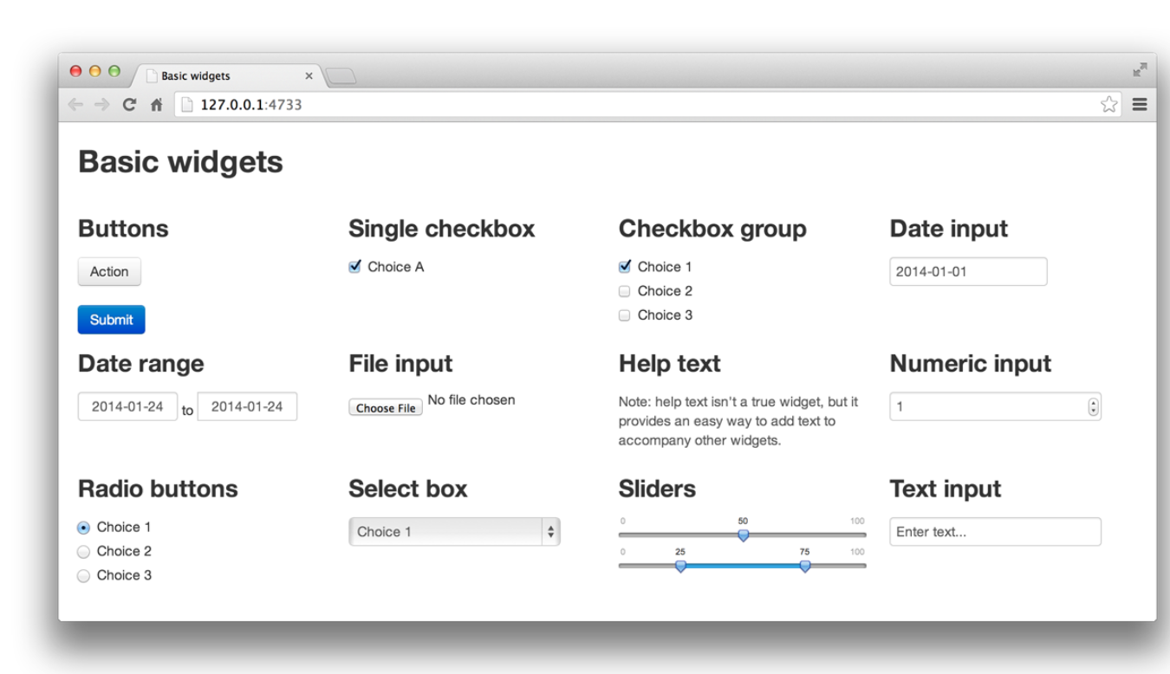
Standard shiny widgets (inputs)

Slide 63
Standard shiny widgets (inputs)
Function Name | Widget
actionButton | Action Button
checkboxGroupInput | A group of check boxes
checkboxInput | A single check box
dateInput | A calendar to aid date selection
dateRangeInput | A pair of calendars for selecting a date range
fileInput | A file upload control wizard
helpText | Help text that can be added to an input form
numericInput | A field to enter numbers
radioButtons | A set of radio buttons
selectInput | A box with choices to select from
sliderInput | A slider bar
submitButton | A submit button
textInput | A field to enter text
Note each function will store different input values:
textInput = a single character element
selectInput = character elements from a list
sliderInput = two numbers in a range
checkboxInput = T / F

Slide 64
Widget components
Each widget function requires several arguments. The first two arguments for each widget are
Name for the widget. The user will not see this name, but you can use it to access the widget’s value. The name should be a character string.
Label. This label will appear with the widget in your app. It should be a character string, but it can be an empty string "".
How you will access the data on server.R:
Input$name
actionButton( “submit", label = “Submit Your Form")
Creates an entry at Input$submit
The remaining arguments vary from widget to widget, depending on what the widget needs to do its job.
numericInput("numInput", "A numeric input:", value = 7, min = 1, max = 30)

Slide 65
Input widgets examples
textInput(“nam”,”Name”)
selectInput(“gen”,”Gender”, choices=c(“Male”,”Female”), selected=“Female”)
sliderInput(“age”,”Ages”, min=0, max=100, value=20, step = 1)
radioButtons(“grad", “Grade”, choices =c(“A”,”B”,”C”,”D”,”F”,”W”), selected = “A”)
More examples can be found at http://shiny.rstudio.com/gallery/widget-gallery.html

Slide 66
Output functions:
The output functions take R code and “render” it as HTML objects that can be used in web browsers in order to display your dashboard. They just translate from R to HTML.
Output Function | Creates
htmlOutput | raw HTML
imageOutput | image
plotOutput | plot
tableOutput | table
textOutput | text
uiOutput | raw HTML
verbatimTextOutput | text

Slide 67
How do the ui and the server communicate= ?
Image Credit: National Socio-Environmental Synthesis Center
https://sesync-ci.github.io/basic-Shiny-lesson/
Notes:
127.0.0.1 is the IP address your laptop uses for itself (it’s the same as ‘localhost’).
Your laptop is hosting a web page (the UI) whose content is controlled by a running R session.
When you run an app through RStudio, that R session is also running the server on your laptop.
The server responds when you interact with the web page, processing R commands and updating UI objects accordingly.
The user interface and the server interact with each other through input and output objects. The user’s interaction with input objects alters parameters in the server’s instructions – instructions for creating output objects shown in the UI.
Writing an app requires careful attention to how your input and output objects relate to each other, i.e. knowing what actions will initiate what sections of code to run at what time.

Slide 68
ui <- fluidPage(
titlePanel("Workshop - Example 1 – Basic Histogram"),
sidebarLayout(
sidebarPanel(
numericInput(inputId="n",
label="Number of observations", value=1000) ),
mainPanel(plotOutput("plot"))
)
)
server <- function(input, output) {
data <- reactive({
x <- rnorm(input$n)
x })
output$plot <- renderPlot({
hist(data(), 50, main="", xlab="x")
})
}

Slide 69
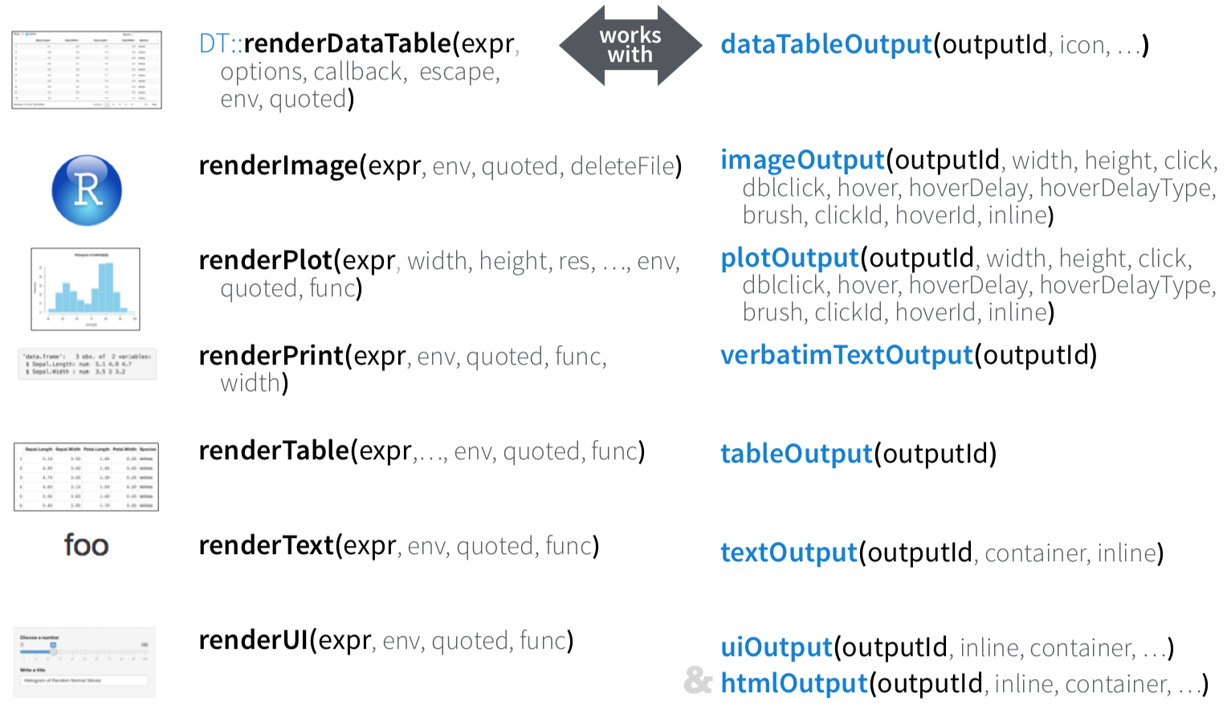
Render and outputs
render*() and *Output() functions work together to add R output to the UI
Server User Interface

Slide 70
More on User Interface

Slide 71
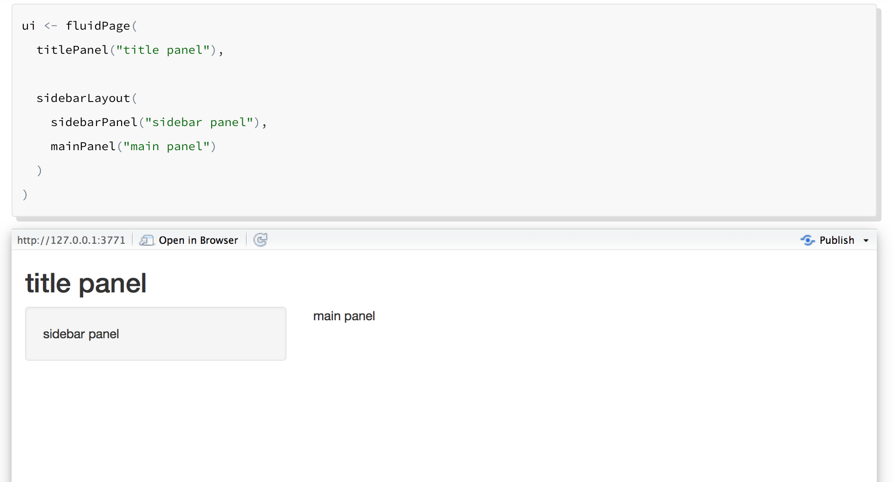
User Interface
Notes:
titlePanel and sidebarLayout are the two most popular elements to add to fluidPage. They create a basic Shiny app with a sidebar.
sidebarLayout always takes two arguments:
sidebarPanel function output
mainPanel function output
These functions place content in either the sidebar or the main panels.

Slide 72
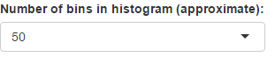
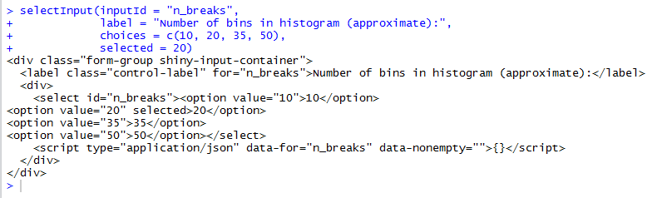
Customize the ui with HTML/CSS
shiny functions that build your user interface are creating HTML code under the hood
R Code
HTML

Slide 73
Customize the ui with HTML/CSS
Tweaking or adding HTML/CSS content can customize the look of your app
Change the relative size of panels
Add additional elements (e.g. headers, paragraphs, links to other content)
Change colors, fonts, and spacing

Slide 74
Customize the ui with HTML/CSS
Adding elements:
HTML elements are building blocks used to create webpages
Elements are surrounded by “tags”
<p>I will become a paragraph.</p>
<h1>I will become a large header.</h1>
shiny has 110 functions, called tags functions, that create HTML elements
tags$p(‘I will become a paragraph.’)
tags$h1(‘I will become a large header.’)
The most common tags functions have helper functions where you can drop the ‘tags$’ part
p(‘I will become a paragraph.’)
h1(‘I will become a large header.’)

Slide 75
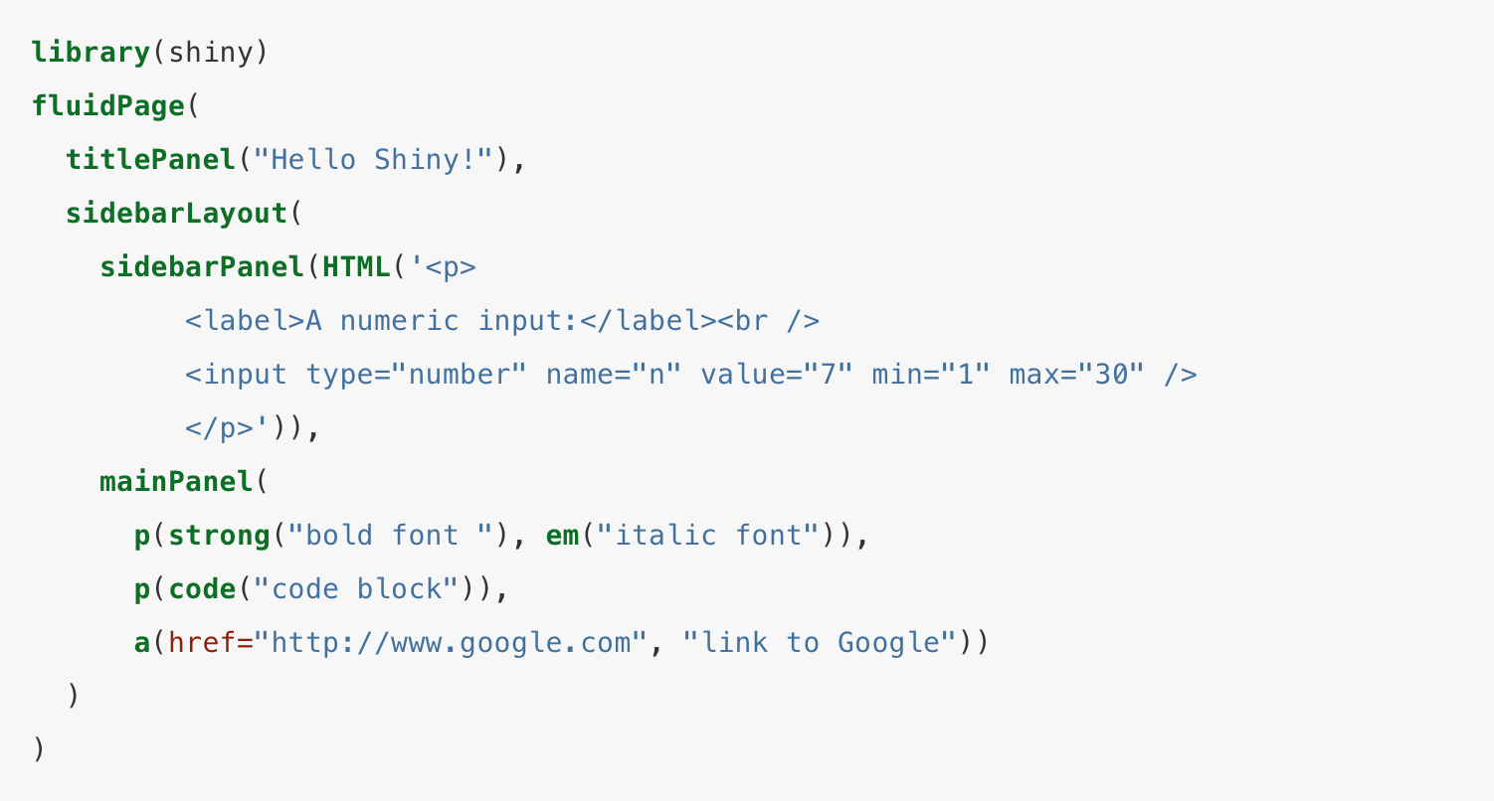
Customize the ui with HTML/CSS

Slide 76
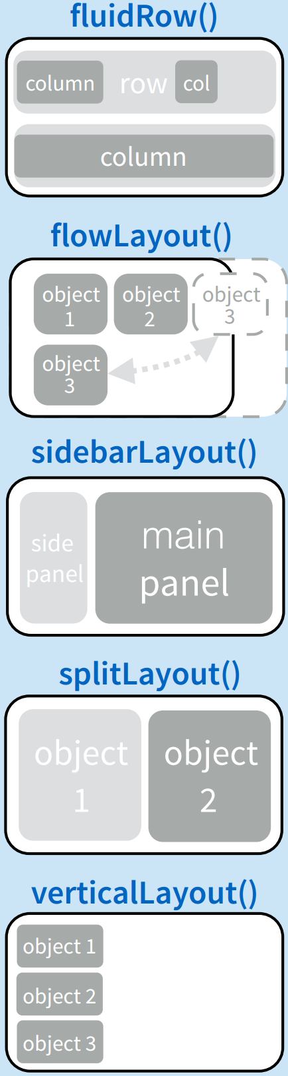
User interface Layouts
titlePanel and sidebarLayout create a basic layout for your Shiny app, but you can also create more advanced layouts.
You can use navbarPage or shinydashboard to give your app a multi-page user interface that includes a navigation bar or side.
Or you can use fluidRow and column to build your layout up from a grid system.

Slide 77
fluidRow: Grid layout
Tweaking lay-outs:
Utilize the fluid “shiny grid system”
Rows sub-divided into 12 columns
Based on popular HTML framework called “Bootstrap”
fluidRow()
fluidRow()
column(1, )
fluidRow()
column(4, )
column(4, )
column(4, )
fluidRow()
column(6, )
column(6, )
column(width = x)
where x is between 1 and 12

Slide 78
A vous de jouer: Exercice 1

